Slide 1
Building Real-time Apps with Firebase

Slide 2
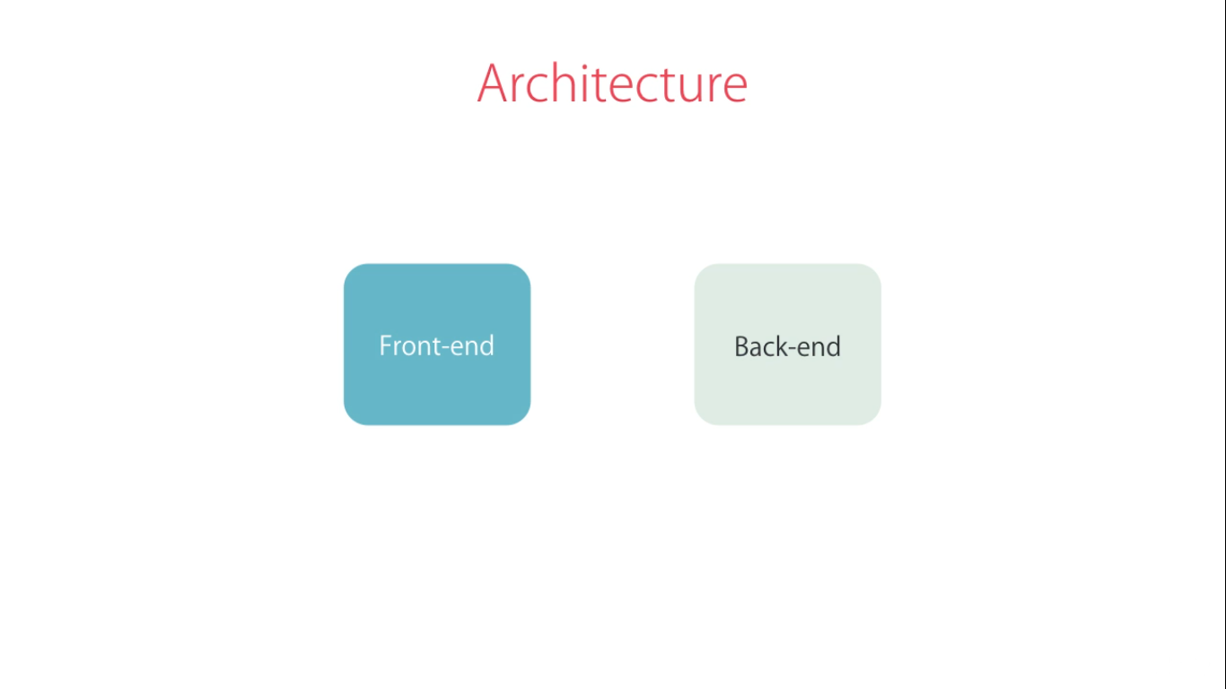

Slide 3
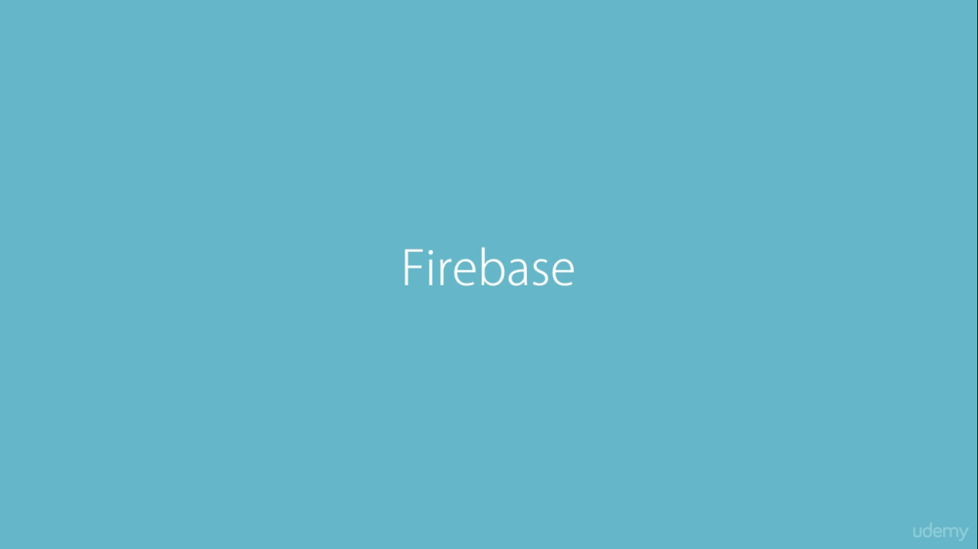

Slide 4
